Slide 1
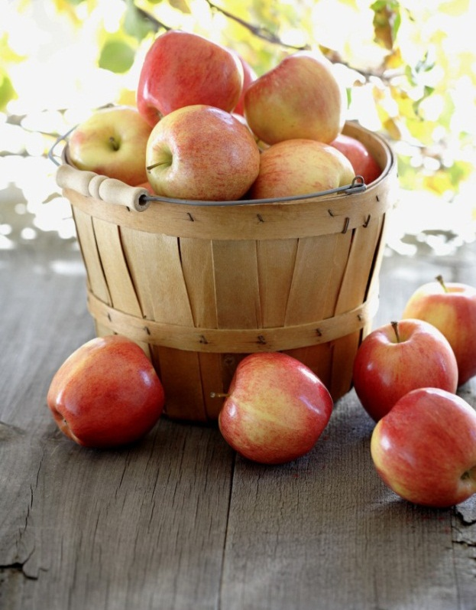

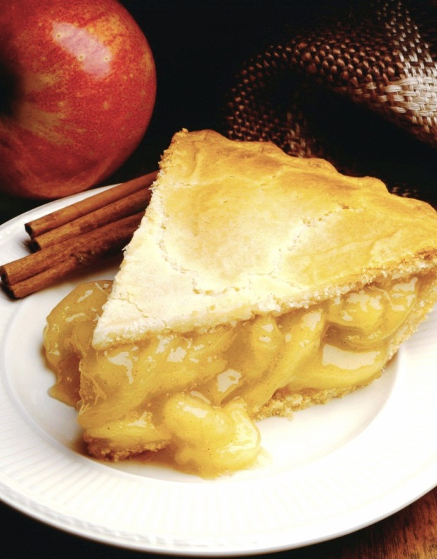
Bite ‘n’ Slice
Food And Restaurant Website
Notes:
NOTE: To replace a picture, just select and delete it. Then use the Insert Picture icon to replace it with one of your own!

Slide 2
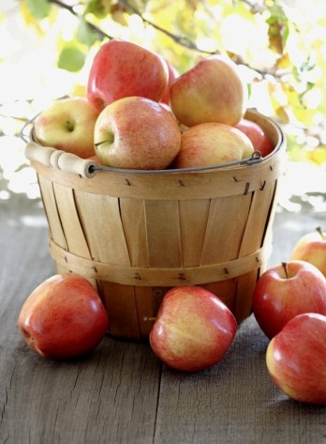
Scope of the project
As we all know that food is the basic need in every human life, for which everyone is struggling. Nowadays, people are occupied with their busy schedules, they either can’t able to cook or not having time to make food and order their food from outside.
Benefits of food ordering platforms:-
The food ordering process easier for customers as well as for restaurant owners.
Easy order management.
Less processing time means less waiting time for food orders.
Live order tracking.
It is very easy to customize the food order.

Slide 3
Specification
Hardware Requirements:
Laptop​
Software Requirements:​
Visual Studio Code For coding
Technology Used:
HTML
CSS
Bootstrap5
JavaScript

Slide 4
Solution Approach
In this project, I build a food and restaurant website through which anyone can order food online.
It is very useful for customers as well as for restaurants in order to manage things easily and increase their revenues.
The website contain a page with many different sections including header, home, about, explore foods, reviews, FAQ, footer.
First there is a navbar which include restaurant logo and different links through which we can visit the whole website easily.
Then comes to the home page which include some text and a button for ordering food. It also includes a counter section which display some figures increasing as soon as the page load.

Slide 5
Solution Approach(Contd..)
Now as we come to about section and we see there is three different sections in that in which everyone have some describing text and a button through which we learn more about the website.
Now come to explore foods section which contain some cards showing the foods and details that the restaurant has.
Then there is a testimonial section which contains the reviews of different people about the restaurant and website.
After that as we come down we get a faq section where there is a number of different question answers which generally people asked. Just after that I give a parallax effect for attractive look.
At last, we saw a newsletter section which includes an input box for taking email address as input. And below that there is a footer of the website which contain links of different social media.

Slide 6
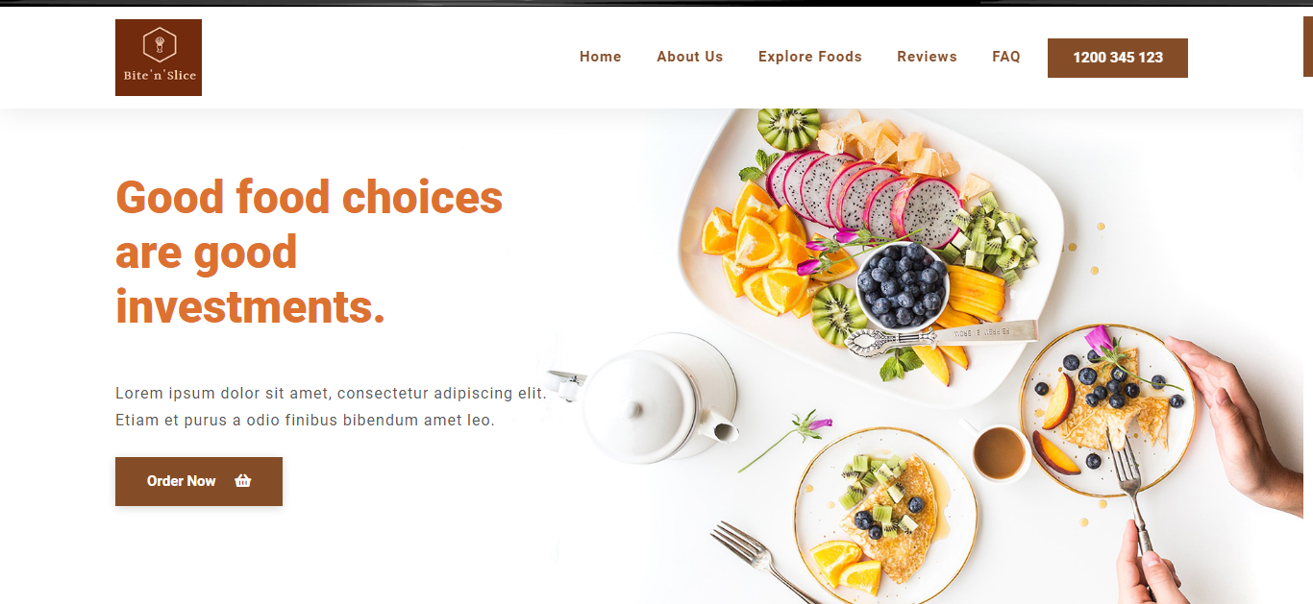
Home Page

Slide 7

Counter Section
**The video will play only when slide show start

Slide 8
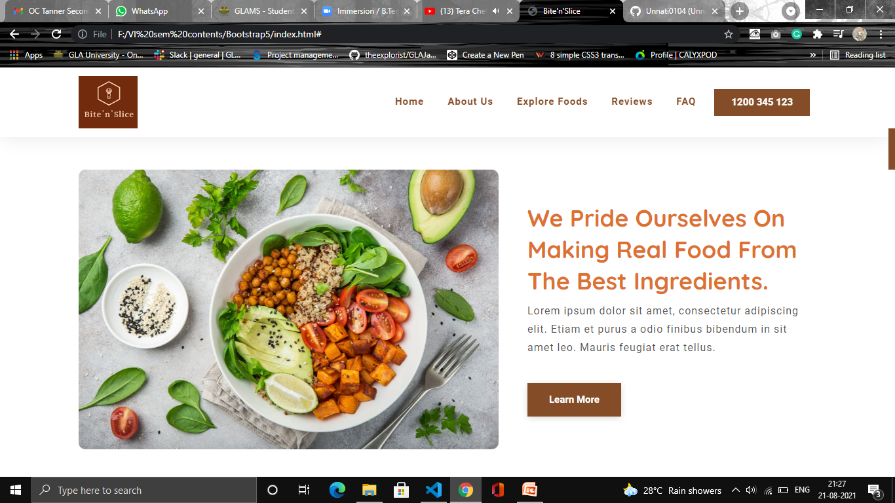
About Us

Slide 9
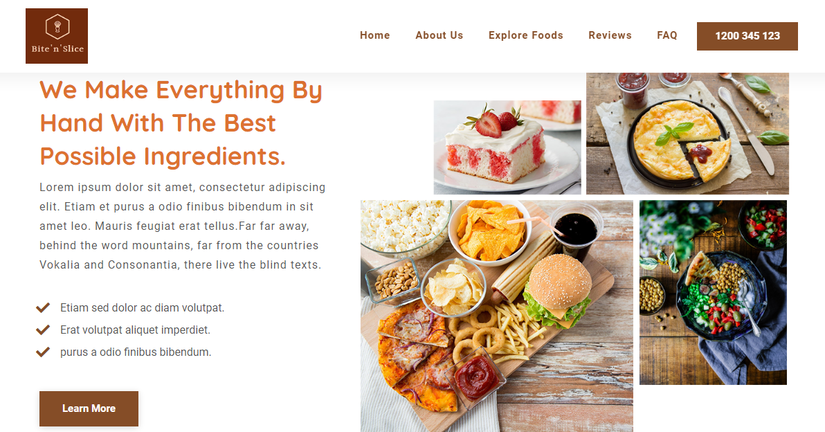
About Us(Contd..)

Slide 10
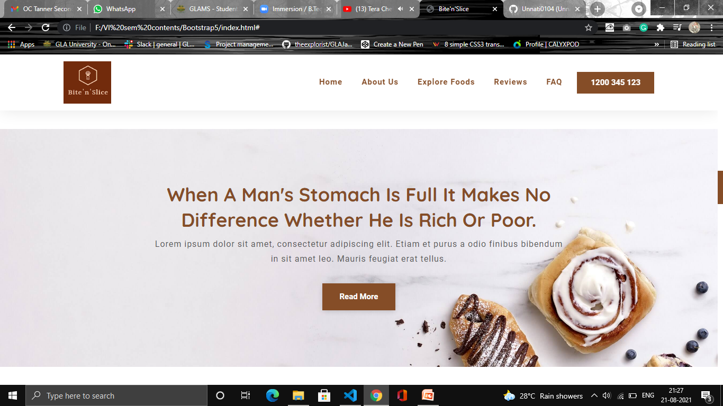
About Us(Contd..)

Slide 11
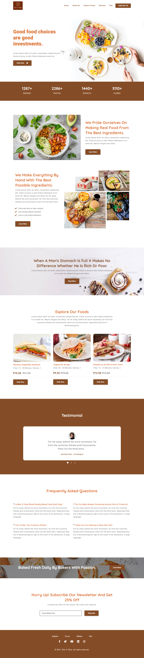
Explore Foods

Slide 12
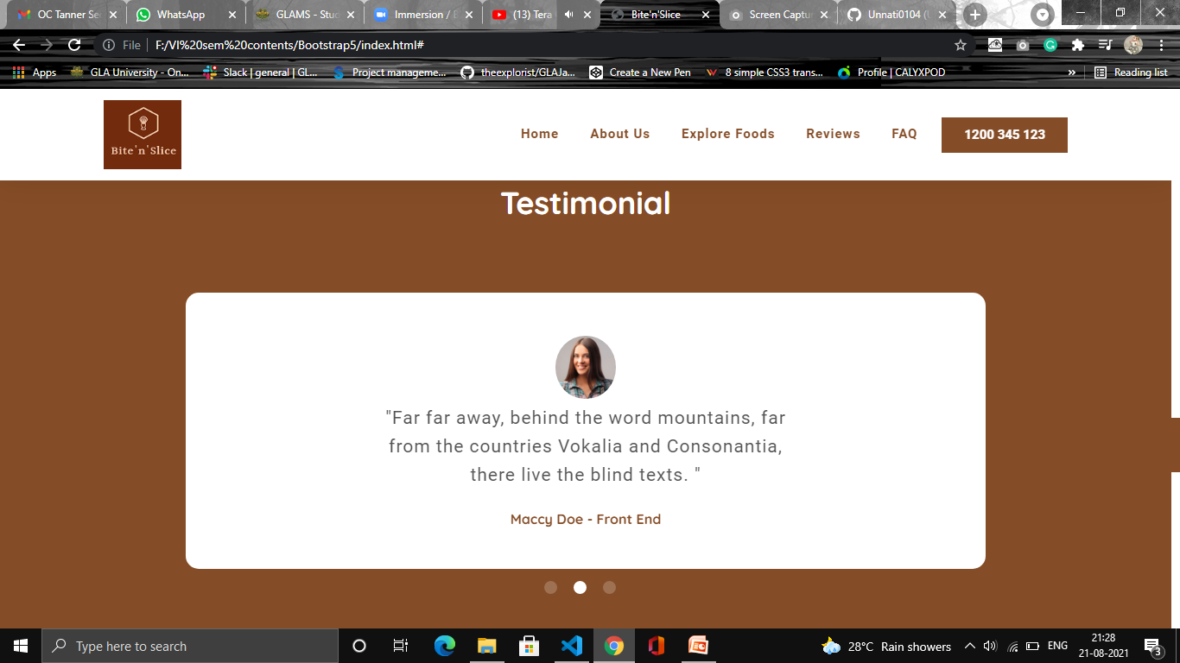
Reviews

Slide 13
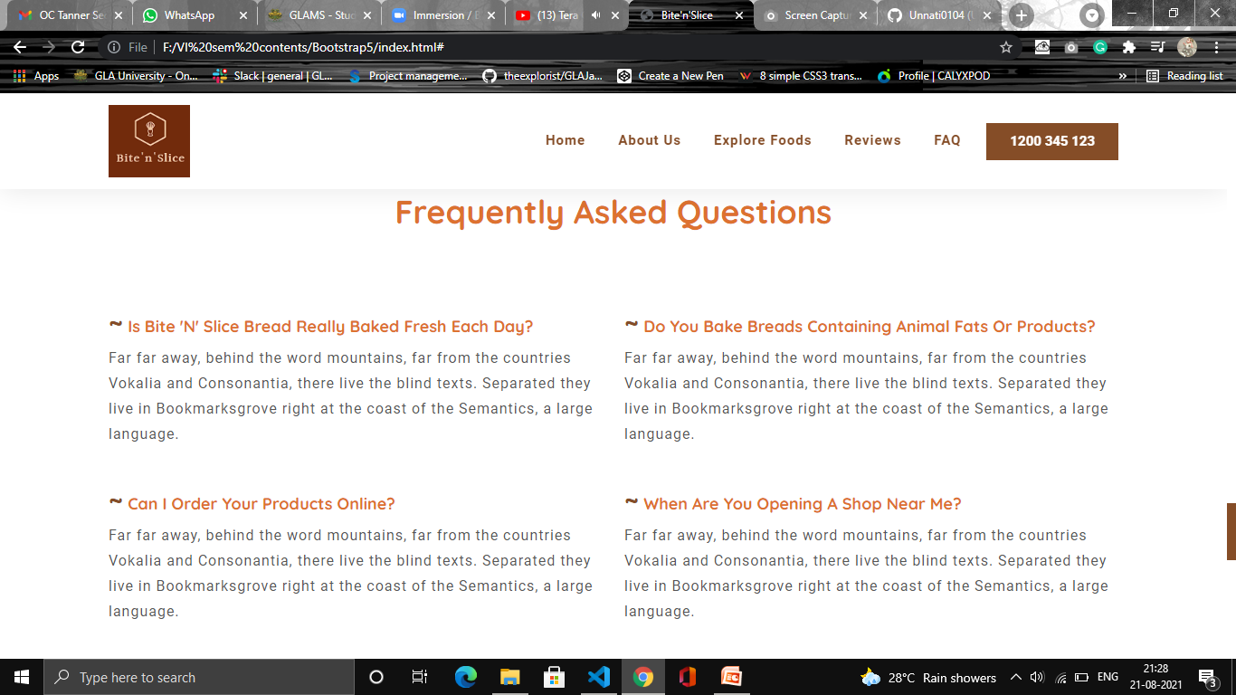
FAQ

Slide 14
Parallax Effect
**The video will play only when slide show start

Slide 15
Newsletter & Footer

Slide 16
Next Steps
In order to extend the website, the first thing I’ll do is to add a login/signup page to have a check on number of people interested in the website.
Ask for few personal details for delivering the order and for confirmation.
Also, I add the other crucial things just after that, like for ordering food we need to check the item availability which is done by maintaining a database.
For payment purpose, we need a secured payment gateway.
For more functionality, we can put filters on food items or on categories.

Slide 17
Thank You
Notes:
NOTE: To replace a picture, just select and delete it. Then use the Insert Picture icon to replace it with one of your own!

